Slide 1
The Minor Prophets
Anything But Minor
Notes:
Welcome back guys…thank you for joining us both in the room and online. I’ll be a week behind in calling you guys out but we had a good group last week…
Laura all the way from Columbia- welcome!; Pam and Charles; Paula Stewart; Sue; Angie and Nelson; Kimberly; Debbie; Lloyd and Marolyn; Glenda; Cathy Galyeon
And live in the building: Jaime and Cathy, Mark and Barbara
I do want you guys to check-in and I welcome your comments. It is encouraging to me to know that you’re there studying with us.
I hope you did your homework and read ahead…there will be a test at the end!
Nobody in house live today except Cathy…due to the weather…let’s pray

Slide 2
The Key To The book: Listen for this!
Prayer “P”
Return “R”
Repent
Rend
Revival comes AFTER Repentance
Notes:
So last week we looked at an overview of the book and tried to set the scene of the devastation. We talked about Joel being God’s PR man because of the specific message delivery that didn’t include all the information that we would want to know.
This message is the key to the book…and it’s about repentance…as a reminder listen for these things as we go through the 3 chapters of Joel.
We won’t see the REND part until chapter 2.

Slide 3
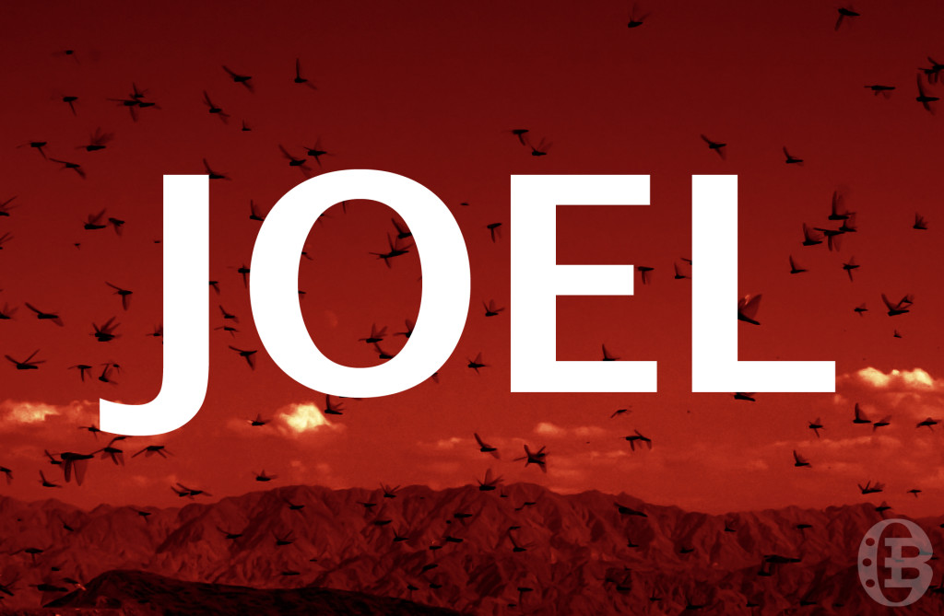
The Coming
DAY OF THE LORD
Notes:
The key to understanding the book is understanding Joel’s Near to Far aspect…Locust have happened…as the locust have wiped out the land…so will the Day of the Lord be towards sinners.
The day of the Lord is mentioned 19 times in the old testament and 4 times in the new testament and we will get into specifics about it as we get further into Joel but for now equate Day of the Lord to Judgment Day…
Last week we took a look at our locust friends and the promise of the plagues of Egypt being on Israel if they were disobedient to the Lord. I read through Moses passages about this quickly last week but want to start with this passage in Deuteronomy. This is what I was attempting to find as we closed last week.

Slide 4
Deuteronomy 28:38-42
Listen for this in the description of Joel chapter 1
Notes:
Listen for this description in Joel chapter 1
You can turn with me to Deuteronomy chapter 28…I’m going to read verses 38-42 (that was my intent last week)
38 You shall carry much seed into the field and shall gather in little, for the locust shall consume it. 39 You shall plant vineyards and dress them, but you shall neither drink of the wine nor gather the grapes, for the worm shall eat them. 40 You shall have olive trees throughout all your territory, but you shall not anoint yourself with the oil, for your olives shall drop off. 41 You shall father sons and daughters, but they shall not be yours, for they shall go into captivity. 42 The cricket shall possess all your trees and the fruit of your ground.
With that picture in your mind lets start with Joel chapter 1. I’m reading from the New American Standard Bible.

Slide 5
Deuteronomy was prophesy for disobedience
Joel chapter 1 is documentation of the prophesied destruction caused by disobedience – direct reflection of God’s promise being fulfilled
Notes:
Last week we talked about the plagues of Egypt…what we just read in Deuteronomy was prophesy for disobedience…but we read shall all the way through it…
Joel chapter 1 is documentation of the prophesied destruction caused by disobedience.

Slide 6
Joel 1 (NASB) The Devastation by Locusts (the near)
1 The word of the LORD that came to Joel, the son of Pethuel:
Notes:
(in this one verse you are all caught up on who Joel is and where his authority to speak comes from.
There are 14 different persons named Joel listed in the old testament. They all appear to be different persons.
This Joel is the son of Pethuel…that’s all you get! He is sometimes known as the anonymous prophet because of this.
We mentioned last week that the name “Joel” is two actually two Hebrew words “Ya” and “El” meaning Jehovah is God. The father’s name…Pethuel is also sometimes called Bethuel with a B. Interesting enough even though we don’t know who his father is either, his fathers name means “vision of God” and comes from the word implying “to open the eyes.”

Slide 7
Joel 1 (NASB) The Devastation by Locusts (the near)
1 The word of the LORD that came to Joel, the son of Pethuel:
Notes:
He is speaking for the Lord…the word for the Lord there is His proper name… Yhvh, Yaw-way…or Jehovah. The name is plural as well describing our 1 God in 3 persons.
There is literally nothing else that talks about Joel’s possible status, rank or standing among the people. Of course he is speaking for the Lord so his authority is spelled out regardless of who else he might have been…it’s a moot point.
We talked last week about time being looked at as an issue with the book of Joel as well since it can’t be dated. It can be before the destruction of the Northern Kingdom or before the exile of the southern kingdom.

Slide 8
Not the when but the what: Repent!
The Key to the book of Joel!
Notes:
Interestingly enough, other prophets will build on what Joel says and the message applies regardless of where he fits in the timeline. So the key is not the when but the what and the what is the message of repentance.
Sadly nowhere in this book do we see any hint that the people repented. Either timeline you look at will show that destruction came in the form of the northern kingdom being conquered by Assyria in 722 BC and the southern kingdom being conquered and exile beginning in 606 BC and completed in 586 BC with the destruction of Jersulaem by Babylon.

Slide 9
Joel 1 (NASB) The Devastation by Locusts (the near)
2 Hear this, you elders, And listen, all inhabitants of the land. Has anything like this happened in your days, Or in your fathers’ days?
Notes:
(this is like nothing you have ever seen. Listen up, hear what I have to say. This message is going to be literally addressed to the entire nation…he says here all inhabitants. He will break it down poetically in these categories leaders, drunkards, citizens, farmers, priests)

Slide 10
Joel 1 (NASB) The Devastation by Locusts (the near)
3 Tell your sons about it, And have your sons tell their sons, And their sons the next generation.
Notes:
(so listen up, you’ve never seen anything like this… This plague was so unusual that Joel says, "tell your children about it." The times were so remarkably difficult that parents would tell their children, "I lived through the plagues of locusts."
This is not the first time we have heard the command to teach future generations…

Slide 11
Deuteronomy 11:19
Remember and Teach
Notes:
Moses gave the Israelites a similar command all through Deuteronomy when reciting God’s word and God’s works.
It was about remembering what the Lord had done, reading, reciting, living the word, remembering God’s awesomeness…being obedient.
Deuteronomy 11:19 says Teach them to your children, talking about them when you sit at home and when you walk along the road, when you lie down and when you get up.
This is important, don’t just hear this but make sure everyone knows it and remembers it.
Moses told them to wear it on their forehead, write it on their door posts, put it everywhere where you will see it.

Slide 12
Joel 1 (NASB) The Devastation by Locusts (the near)
4 What the gnawing locust has left, the swarming locust has eaten;
And what the swarming locust has left, the creeping locust has eaten;
And what the creeping locust has left, the stripping locust has eaten.
Notes:
Joel isn't announcing a coming judgment of the Lord. He describes their present state – this had happened because of the disobedience of the people.
it’s going to be key because it’s the near and far picture comparison that Joel is going to use.
(the Hebrew word here for what the different types of locust means is uncertain. The NIV says what the great swarm has left, the young locust has eaten, what they have left the other locust has eaten.

Slide 13
Joel 1 (NASB) The Devastation by Locusts (the near)
4 What the gnawing locust has left, the swarming locust has eaten;
And what the swarming locust has left, the creeping locust has eaten;
And what the creeping locust has left, the stripping locust has eaten.
Notes:
It literally means that whether this is
4 different types of locust,
4 different stages in the locust life, or
4 different waves of locust…
it’s going to be so bad that nothing is left…literally the bark is stripped. The land was devastated by successive swarms of locusts, first chewing, then swarming, then crawling, and finally consuming.
Judah will experience a time of famine and financial ruin because of these locusts.

Slide 14
Joel 1 (NASB) The Devastation by Locusts (the near)
4 What the gnawing locust has left, the swarming locust has eaten;
And what the swarming locust has left, the creeping locust has eaten;
And what the creeping locust has left, the stripping locust has eaten.
Notes:
Why is this so bad…other than the fact it mirrors the plague in Egypt where is says literally nothing green was left in the entire land…remember that agriculture was key to the people here.
Everything depended on it…life literally revolved around it.
And remember that God’s promise was a land flowing with milk and honey…everything in the land would be prosperous but he also promised the exact opposite if the people were not faithful…so a land of death and destruction.
This is what Joel is crying out against…the devastation that the locust plague has caused is due to disobedience. We need to repent because literally something far worse than these locust is coming!

Slide 15
Joel 1 (NASB) The Devastation by Locusts (the near)
5 Awake, you heavy drinkers, and weep; And wail, all you wine drinkers, Because of the sweet wine, For it has been eliminated from your mouth.
6 For a nation has invaded (gone up against) my land, Mighty and without number; Its teeth are the teeth of a lion, And it has the jaws of a lioness.
7 It has made my vine a waste And my fig tree a stump. It has stripped them bare and hurled them away; Their branches have become white.
Notes:
(People…Wake up…sober up…your supply has been cut off. See the devastation that the locust have caused. …)
(Joel is comparing the locust swarm to a nation that has gone up against the actual land of Israel…later on he will use this as a comparison. The swarm is strong and has laid waste to the entire land. They came like a mighty nation, a fierce army against Judah.
He uses My vine … My fig tree: vine and fig tree is often used to describe Jesus and Israel or God’s people

Slide 16
John 15:1-17
The Vine and the Branches
Notes:
Turn to John 15 with me…
15 “I am the true vine, and my Father is the gardener. 2 He cuts off every branch in me that bears no fruit, while every branch that does bear fruit he prunes so that it will be even more fruitful. 3 You are already clean because of the word I have spoken to you. 4 Remain in me, as I also remain in you. No branch can bear fruit by itself; it must remain in the vine. Neither can you bear fruit unless you remain in me.
5 “I am the vine; you are the branches. If you remain in me and I in you, you will bear much fruit; apart from me you can do nothing. 6 If you do not remain in me, you are like a branch that is thrown away and withers; such branches are picked up, thrown into the fire and burned. 7 If you remain in me and my words remain in you, ask whatever you wish, and it will be done for you. 8 This is to my Father’s glory, that you bear much fruit, showing yourselves to be my disciples.

Slide 17
John 15:1-17
The Vine and the Branches
Notes:
Turn to John 15 with me…
9 “As the Father has loved me, so have I loved you. Now remain in my love. 10 If you keep my commands, you will remain in my love, just as I have kept my Father’s commands and remain in his love. 11 I have told you this so that my joy may be in you and that your joy may be complete.
12 My command is this: Love each other as I have loved you. 13 Greater love has no one than this: to lay down one’s life for one’s friends. 14 You are my friends if you do what I command. 15 I no longer call you servants, because a servant does not know his master’s business. Instead, I have called you friends, for everything that I learned from my Father I have made known to you. 16 You did not choose me, but I chose you and appointed you so that you might go and bear fruit—fruit that will last—and so that whatever you ask in my name the Father will give you. 17 This is my command: Love each other.

Slide 18
Matthew 3:10
Call to Repent
Notes:
Now Matthew 3:10
…9And do not presume to say to yourselves, ‘We have Abraham as our father.’ For I tell you that out of these stones God can raise up children for Abraham. 10The axe lies ready at the root of the trees, and every tree that does not produce good fruit will be cut down and thrown into the fire. 11I baptize you with water for repentance, but after me will come One more powerful than I, whose sandals I am not worthy to carry. He will baptize you with the Holy Spirit and with fire.…
God looks at the vines and fig trees of Judah and says they belong to Him, even in judgment. The locust have destroyed everything related to the vine and trees and Joel is saying it’s God judging his people…wake up!

Slide 19
Joel 1 (NASB) The Devastation by Locusts (the near)
8 Wail like a virgin clothed with sackcloth For the groom of her youth.
Notes:
Joel is telling the people to mourn with the same emotion and passion that a young widow would have over her husband who has passed away.
This is not accidental or passing thing. This really hurts so lets take our pain to our God. The only way to deal with this suffering is to Turn back to Him.

Slide 20
Joel 1 (NASB) The Devastation by Locusts (the near)
9 The grain offering and the drink offering have been cut off From the house of the LORD. The priests mourn, The ministers of the LORD.
10 The field is ruined, The land mourns; For the grain is ruined, The new wine has dried up, Fresh oil has failed.
11 Be ashamed, you farm workers, Wail, you vinedressers, For the wheat and the barley; Because the harvest of the field is destroyed.
12 The vine has dried up And the fig tree has withered; The pomegranate, the palm also, and the apple tree, All the trees of the field have dried up. Indeed, joy has dried up From the sons of mankind.
Notes:
Read verses…
(Joel is describing total devastation all the way throughout the land; it’s all been destroyed…there is no more normal.
All the people should be ashamed…even the land is crying out. (because of the devastation…the agriculture is gone.
Apparently this was the only thing that had stopped the offerings. The people had remained in their wicked ways. The religion of the people had been corrupted. God stopped it with the destruction of the land and Joel pointed to this as a sign of God’s judgment on the land and coming judgment on the people.

Slide 21
Deuteronomy 28:15
Back to the Future…in the past!
Notes:
15 “But it shall come about, if you do not obey the Lord your God, to be careful to follow all His commandments and His statutes which I am commanding you today, that all these curses will come upon you and overtake you:
Moses goes on to talk about every part of life will be cursed.
13 The Lord will make you the head, not the tail. If you pay attention to the commands of the Lord your God that I give you this day and carefully follow them, you will always be at the top, never at the bottom.
Literally both sides the coin are described…the heads and that tails…and you want to be the head and not the tail! (the first coin toss…and they lost!)

Slide 22
Deuteronomy 28:15
Back to the Future…in the past!
Notes:
Some scholars believe that Joel and Amos were contemporaries…we will see when we get to Amos that he does tend to expound on what Joel is saying.
By the way when we talk about judgment in the Day of the Lord…all the way through the bible, both old and new testament, the message matches, some go into more detail but everything matches up.
That’s what we call a clue that the message remains the same today…the warning the Joel is giving applies to us today. It’s the same message from Genesis to Revelation.

Slide 23
Amos 5:21-23
No delight in religion that doesn’t include the heart!
Notes:
Turn to Amos chapter 5…verse 21-23
Amos says this in Amos 5:21-23
21 “I hate, I reject your festivals, Nor do I [a]delight in your festive assemblies. 22 Even though you offer up to Me burnt offerings and your grain offerings, I will not accept them; And I will not even look at the peace offerings of your fattened oxen. 23 Take away from Me the noise of your songs; I will not even listen to the sound of your harps.
Now back in verse 13 of Joel…The call to repent…cry out

Slide 24
Joel 1 (NASB) The Devastation by Locusts (the near)
13 Put on sackcloth (an outward sign) And mourn, you priests; Wail, you ministers of the altar! Come, spend the night in sackcloth, You ministers of my God, For the grain offering and the drink offering Have been withheld from the house of your God.
Notes:
Read verses…
(Joel starts with the priests and ministers. He calls for them to lead in crying out; to lament, to wail, to pray, to show the outward signs of mourning…not only is the land destroyed but it means that offerings that sustain the priests and ministers have dried up as well.
Sackcloth and ashes was the outward sign to show mourning
So step one…cry out to God, Prayer, the outward sign to mourn by putting on sackcloth…he will take this a step farther a little bit later on.)

Slide 25
Joel 1 (NASB) Starvation and Drought (the near)
14 Consecrate a fast, Proclaim a solemn assembly; Gather the elders And all the inhabitants of the land. To the house of the LORD your God, And cry out to the LORD.
Notes:
Read verses…
(consecrate means to sanctify…or set apart…a fast. He is saying to set yourselves apart from what you have been doing, what you want to do and concentrate on what God wants, your relationship with Him.
The purpose of the fast is to take anything that would take your attention away from God, set it aside, and focus directly and totally on God. Joel is telling them, look everything that you have been depending upon to bring you happiness is now gone. Return to God.)

Slide 26
Joel 1 (NASB) Starvation and Drought (the near)
14 Consecrate a fast, Proclaim a solemn assembly; Gather the elders And all the inhabitants of the land. To the house of the LORD your God, And cry out to the LORD.
Notes:
Proclaim a solemn assembly;
(Question: "What is a solemn assembly in the Bible?“
Answer: In the Bible, a solemn assembly is a gathering of the people of Israel for a sacred feast, festival, or holy occasion. A solemn assembly included a ritual of purification or observing a state of holiness in which all the people of the community were commanded to do no work. The solemn assembly is also called a “sacred assembly” and a “solemn meeting.”

Slide 27
Joel 1 (NASB) Starvation and Drought (the near)
14 Consecrate a fast, Proclaim a solemn assembly; Gather the elders And all the inhabitants of the land. To the house of the LORD your God, And cry out to the LORD.
Notes:
One Hebrew word translated “solemn assembly” means “a day of restraint”—primarily from work.
Another Hebrew term rendered “solemn assembly” denotes a unique, appointed time set apart for the keeping of festivals. On these special worship occasions, the whole community gathered together for either a feast or a fast day.)
All inhabitants of the land…not even a built in excuse about the kids here…Earlier Joel was saying to teach the kids…now Joel is saying bring them all, even the kids…and when you get them all together and everything else has been set aside…cry out to God)

Slide 28
What Repentance Looks Like So Far:
Fast
Call a Sacred Assembly
Gather the Elders
Go into the House of the Lord
CRY OUT
NOT IF or maybe WHEN YOU FEEL LIKE IT!!!!
Notes:
Fast – remove the things that are important and concentrate on what is important…oh yeah that would be YOUR GOD
Call a sacred assembly – God’s people need to gather together in one body and in one spirt of repentance
Gather the elders – the leaders need to repent and lead the people in repenting
Into the House of the Lord – go to the place set apart for worship
And Cry out – cry out to your God. Put your faith in His ability to rescue you. This is key for physical deliverance and for spiritual deliverance
NOTE THE LAST PART>>>

Slide 29
Woe for the day!
That’s the near…
Notes:
Ok so now you know the near…it’s bad! We will pick up there next week Lord willing.
Thank you guys again for joining us…let’s pray!

